Slide 1
Internship With MLSA in Full Stack Web Development
By- Abhishek Chaudhary
Roll No: 2300290120012
Branch: CS
Year: 2nd

Slide 2
Introduction to Internship
During my online internship with MLSA, I focused on Full Stack Web Development.
This presentation will provide an overview of my key projects, including ‘ styling a web page ‘ and a ‘ Calculator website’ .

Slide 3
Overview of Full Stack Development
Full Stack Development involves both frontend and backend technologies.
I gained hands-on experience in HTML, CSS, and JavaScript for the frontend, while exploring Node.js and Express for backend development.
This comprehensive approach allowed me to understand the entire web development process

Slide 4
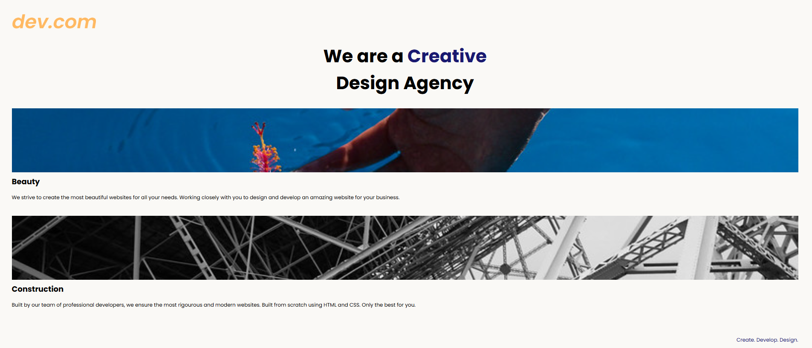
Project 1: style a web pages (Easy)
Objective:
To style a web page
Key Features:
To decorate and looking good we are using the styling of the web page and it provide a better visual experience and a easy access of the thing you wanted to show to the user .

Slide 5
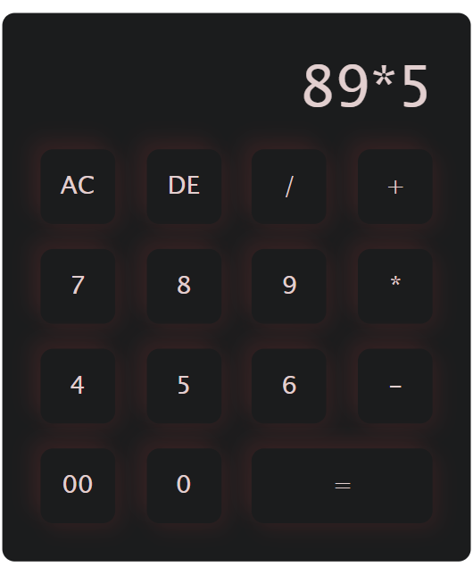
Project 2: Calculator Website (Intermediate)
Objective:
To perform basic arithmetic operation using web-based Calculator.
Key Features:
The Calculator Application project aimed to create an interface for performing basic arithmetic operations. I utilized JavaScript for functionality and ensured a responsive design using CSS.

Slide 6
Conclusion and Future Goals
In conclusion, the MLSA intership is a best experience inhand practice and depth learning about web dev.
Enhancing my technical skills and preparing me for future challenges.
I aim to further explore advanced web technologies and contribute to impactful projects in the field of web development.

Slide 7
Thank You !

